Slide 1
Data Visualization in Python using matplotlib

Slide 2
Learning Objectives
By the end of this lesson, you will be able to:
Explain data visualization and its importance
Illustrate why Python is considered one of the best data visualization tools
Describe matplotlib and seaborn and its data visualization features in Python
List the types of plots and the steps involved in creating these plots

Slide 3
Data Visualization
Data visualization is a technique to present the data in a pictorial or graphical format.
The main benefits of data visualization are:
Explores new patterns and reveal hidden patterns
Identifies the relationship between data point and variables
Analyze and explore big data easily
Simplifies the complex quantitative information

Slide 4
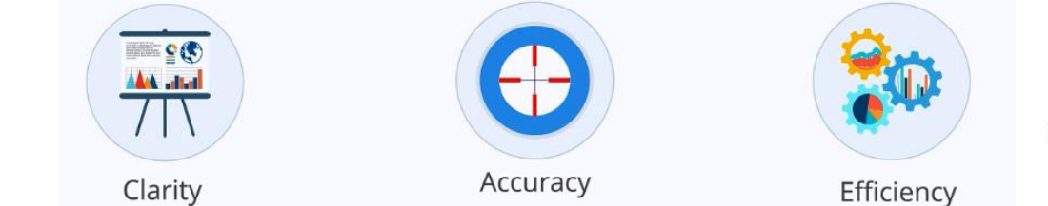
Considerations of Data Visualization
Three major considerations for data visualization:

Slide 5
Considerations of Data Visualization
Clarity: Ensure the dataset is complete and relevant. This enables the Data Scientist to use the new patterns obtained from the data in the relevant places.
Accuracy: Ensure you use appropriate graphical representation to convey the intended message
Efficiency: Use efficient visualization techniques that highlight all the data points

Slide 6
Factors of Data Visualization
Visual effect: The visual effect includes the usage of appropriate shapes, colors, and sizes to represent the analyzed data.
The coordinate system: The coordinate system helps organize the data points within the provided coordinates
Data type and scale: The data types and scale choose the type of data, for example, numeric or categorical.
The informative interpretation: The informative interpretation helps create visuals in an effective and easily interpretable manner using labels, title, legends, and pointers.

Slide 7
Python Libraries
Many new Python data visualization libraries are introduced recently, such as:
Matplotlib is a data visualization library and 2-D plotting library of Python It was initially released in 2003 and it is the most popular and widely-used plotting library in the Python community. It comes with an interactive environment across multiple platforms. Matplotlib can be used in Python scripts, the Python and IPython shells, the Jupyter notebook, web application servers, etc.

Slide 8
Seaborn is a Python data visualization library that is based on Matplotlib and closely integrated with the NumPy and pandas data structures. Seaborn has various dataset-oriented plotting functions that operate on data frames and arrays that have whole datasets within them. It is a high-level interface for creating beautiful and informative statistical graphics that are integral to exploring and understanding data. The Seaborn data graphics can include bar charts, pie charts, histograms, scatterplots, error charts, etc. Seaborn also has various tools for choosing color palettes that can reveal patterns in the data.

Slide 9
GGplot is a Python data visualization library that is based on the implementation of ggplot2 which is created for the programming language R. GGplot can create data visualizations such as bar charts, pie charts, histograms, scatterplots, error charts, etc. using high-level API. It also allows you to add different types of data visualization components or layers in a single visualization. Once ggplot has been told which variables to map to which aesthetics in the plot, it does the rest of the work so that the user can focus on interpreting the visualizations and take less time in creating them. But this also means that it is not possible to create highly customized graphics in ggplot. Ggplot is also deeply connected with pandas so it is best to keep the data in DataFrames

Slide 10
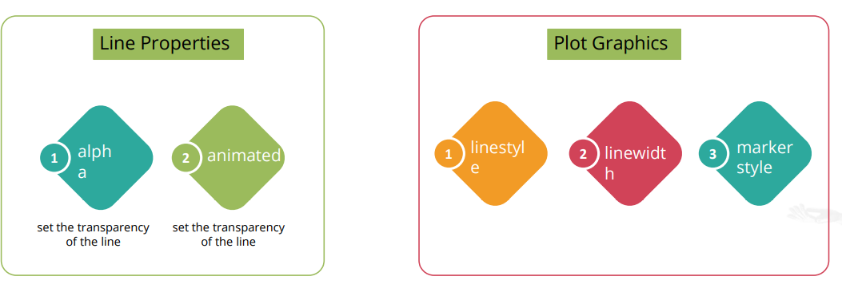
Line Properties

Slide 11
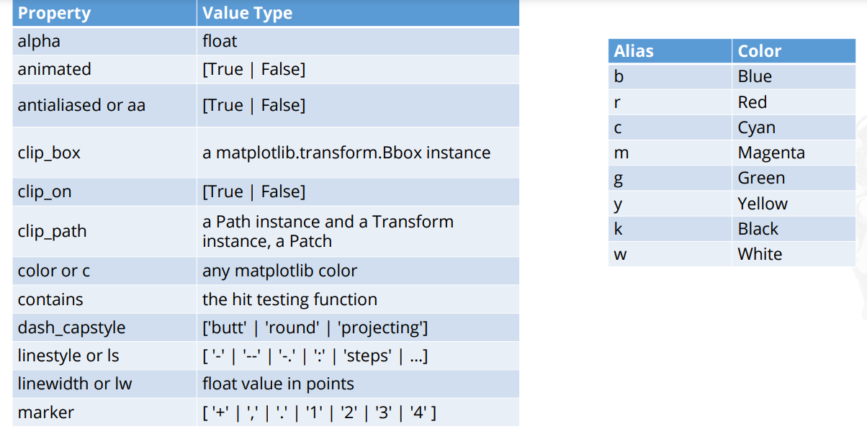
Line Properties

Slide 12
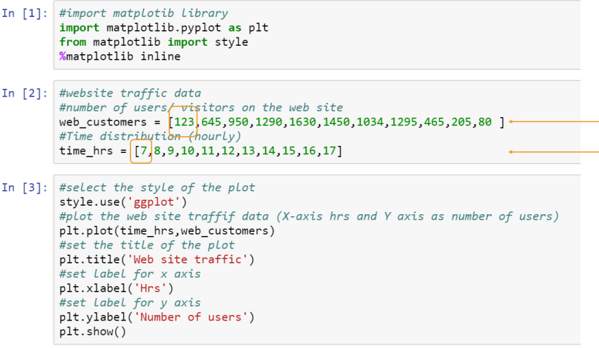
Plot with (X,Y)

Slide 13
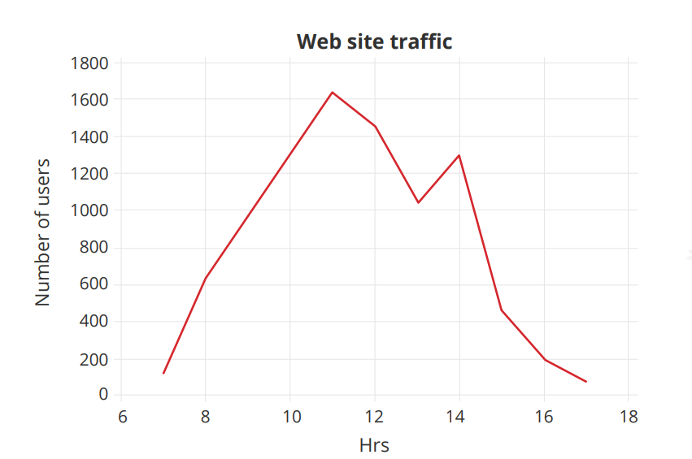

Slide 14
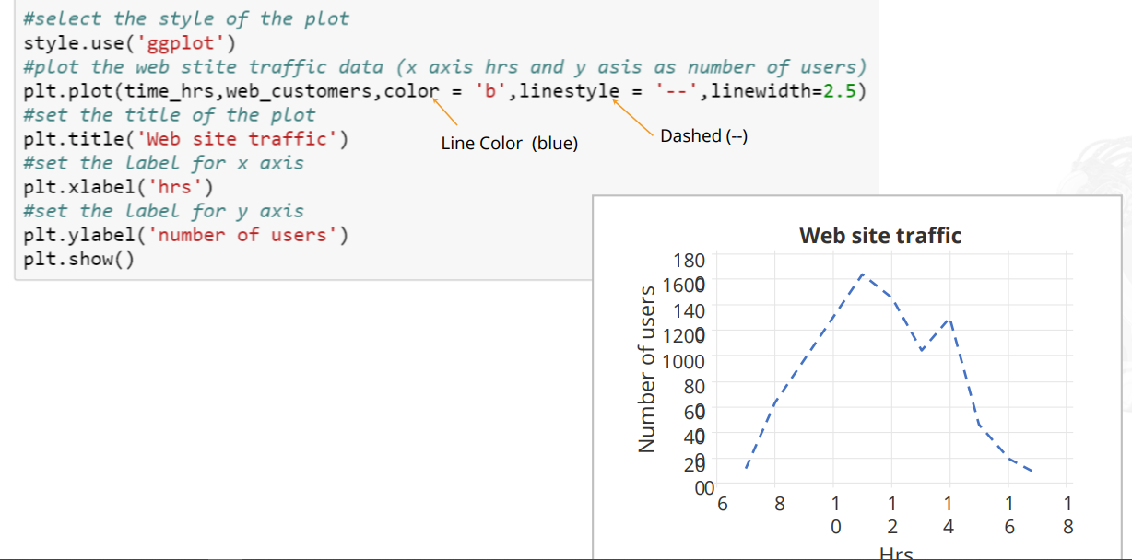
Controlling Line Patterns and Colors

Slide 15
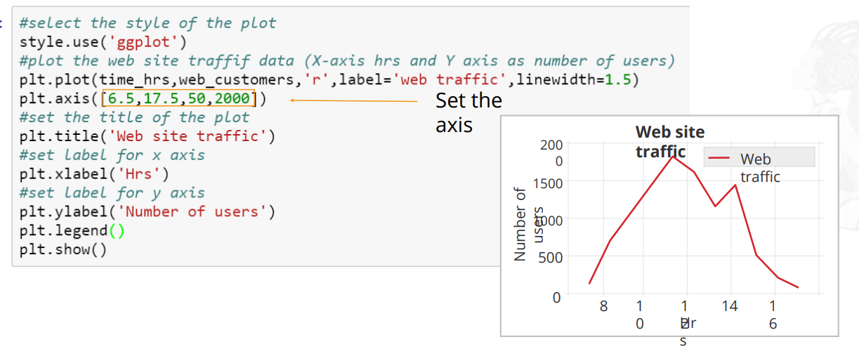
Set Axis, Labels, and Legend Property
Using matplotlib, it is also possible to set the desired axis to interpret the result.Axis is used to define the range on the x axis and y axis.

Slide 16
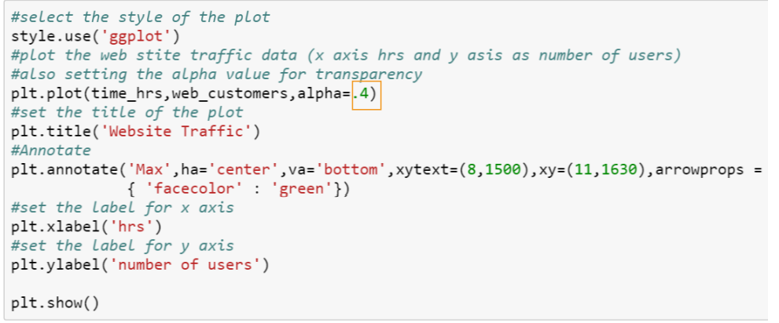
Alpha and Annotation
Alpha is an attribute that controls the transparency of the line.
The lower the alpha value, the more transparent the line is.

Slide 17
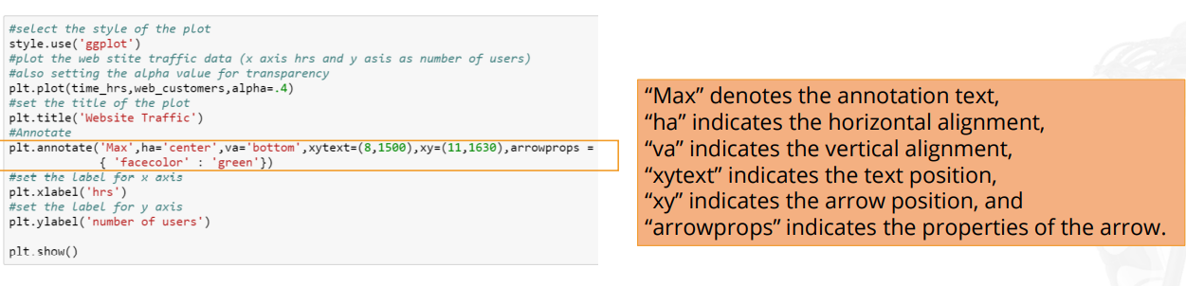
Annotate() method is used to annotate the graph. It has several attributes which help annotate the plot.

Slide 18
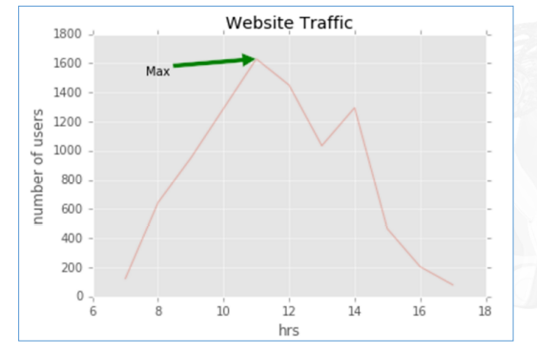

Slide 19
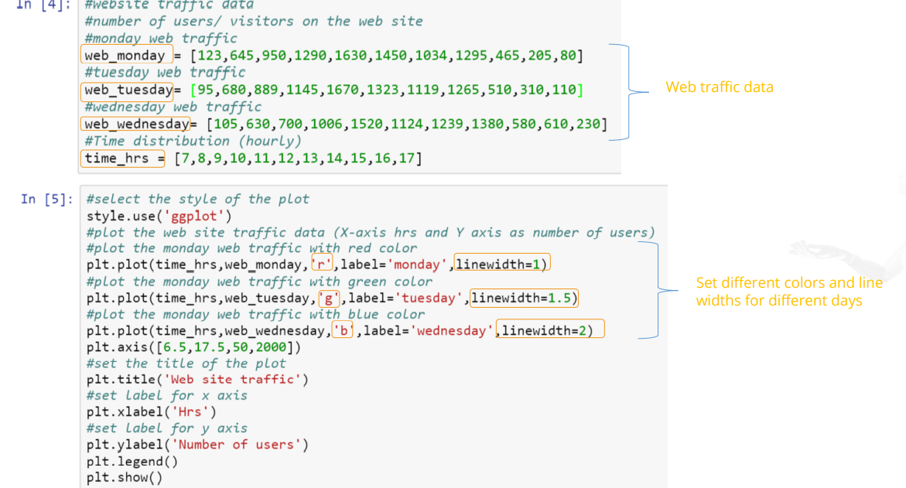
Multiple Plots

Slide 20
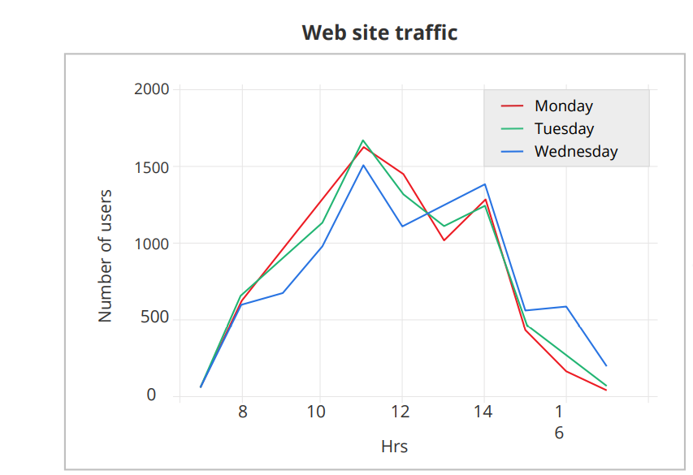

Slide 21
Alpha and Annotation
Alpha is an attribute that controls the transparency of the line.The lower the alpha value, the more transparent the line is.
Annotate() method is used to annotate the graph. It has several attributes which help annotate the plot.

Slide 22
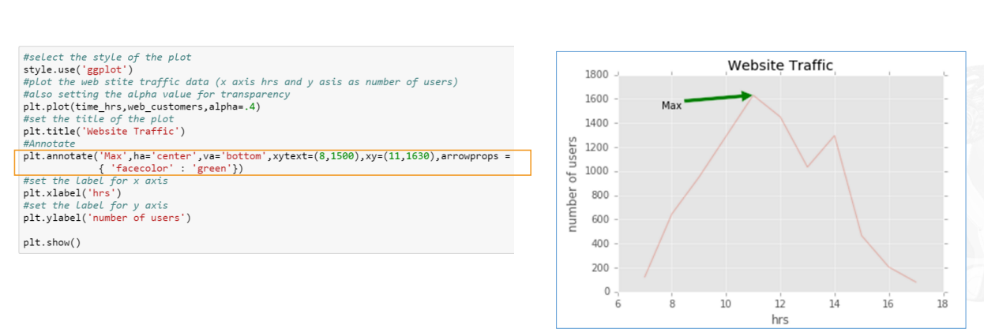

Slide 23
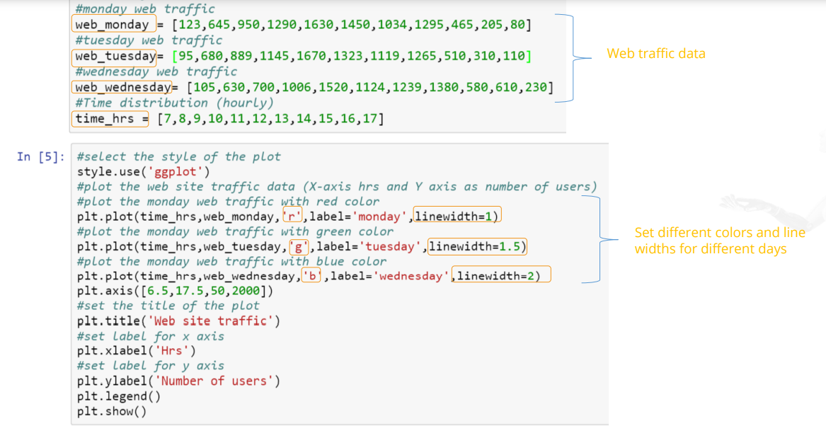
Multiple Plots

Slide 24
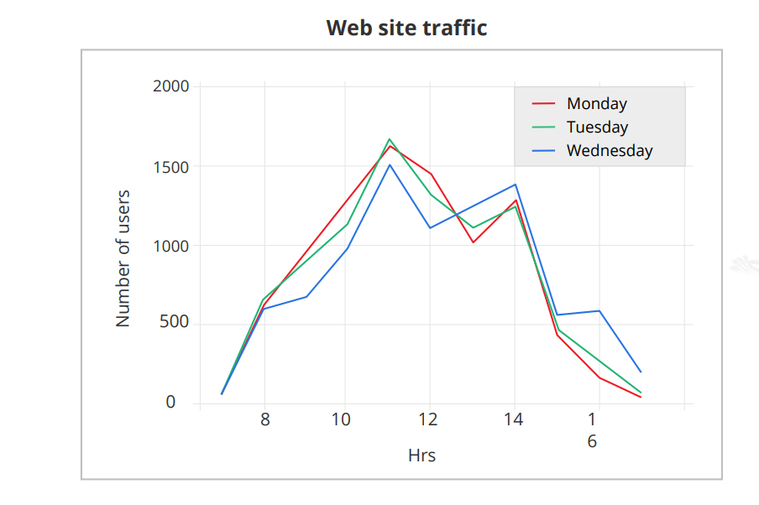

Slide 25
Subplots
Subplots are used to display multiple plots in the same window.
With subplot, you can arrange plots in a regular grid.
The syntax for subplot is: subplot(m,n,p).
Where m = number of rows, n= number of columns and p= number of plot.

Slide 26
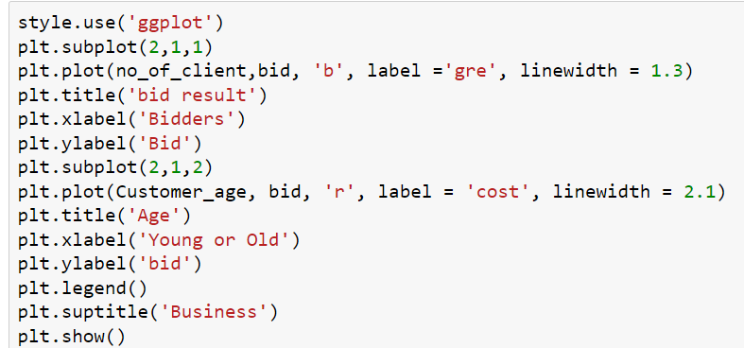

Slide 27
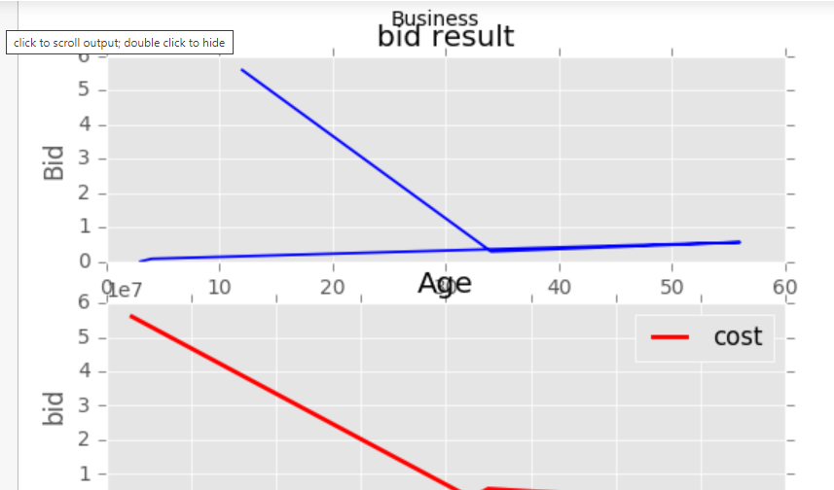

Slide 28
HISTOGRAM
Histograms are graphical representations of a probability distribution. A histogram is a kind of a bar chart. Using matplotlib and its bar chart function, you can create histogram charts.
Advantages of Histogram charts:
They display the number of values within a specified interval.
They are suitable for large datasets as they can be grouped within the intervals.

Slide 29
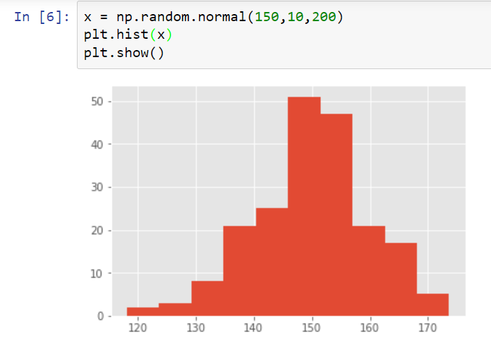

Slide 30
SCATTER PLOT
A scatter plot is used to graphically display the relationships between variables.However, to control a plot, it is recommended to use scatter() method
It has several advantages:
Shows the correlation between variables
Is suitable for large datasets
Is easy to find clusters
Is possible to represent each piece of data as a point on the plot

Slide 31
HEAT MAP
A heat map is a way to visualize two-dimensional data. Using heat maps, you can gain deeper and faster insights about data than other types of plots.
It has several advantages:
Draws attention to the risk-prone area
Uses the entire dataset to draw meaningful insights
Is used for cluster analysis and can deal with large datasets

Slide 32
PIE CHARTS
Pie charts are used to show percentage or proportionaldata.
Matplotlib provides the pie() method to create pie charts
It has several advantages:
Summarizes a large dataset in visual form
Displays the relative proportions of multiple classes of data
Size of the circle is made proportional to the total quantity

Slide 33
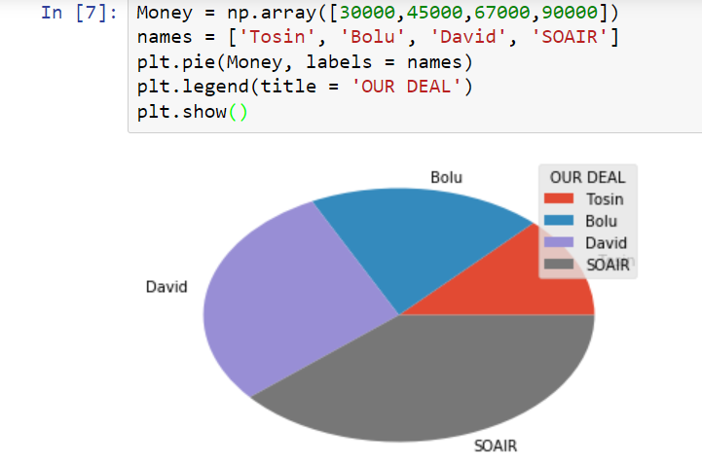

Slide 34
ERROR BAR
An error bar is used to graphically represent the variability of data. It is used mainly to identify errors. It builds confidence about the data analysis by revealing the statistical difference between the two groups of data.
It has several advantages:
Shows the variability in data and indicates the errors.
Depicts the precision in the data analysis.
Demonstrates how well a function and model are used in the data analysis.
Describes the underlying data.

Slide 35
Seaborn
Seaborn is a Python visualization library based on matplotlib. It provides a high-level interface to draw attractive statistical graphics.
There are several advantages:
Possesses built-in themes for better visualizations
Has functions to visualize matrices of data
Has built-in statistical functions which reveal hidden patterns in the dataset

Slide 36
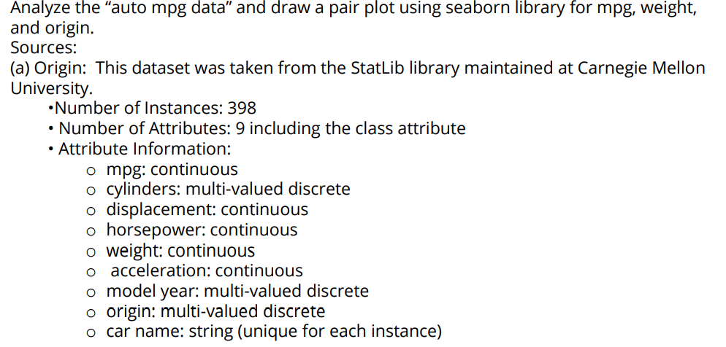
PROJECT 1

Slide 37
PROJECT 2
On your jupyter notebook, list five leading causes of death in Nigeria and ascribe percentages to each list. Plot a pie chart to show both the causes and the percentiles.

